Slide 1
CSE514 – Datamining Fall 2022 Deep Learning
Cynthia Ma
Department of Computer Science
Washington University in St. Louis
czma@wustl.edu

Slide 2
Quick admin follow-up
HW0 and HW1 grades are finalized
How grading and the late penalty works:
Submissions are graded during the two weeks after first deadline
If late, your score is multiplied by 0.8
HW2 was due last night, late deadline is midnight next Tuesday (Sept 27)

Slide 3
What makes an ANN Deep Learning?
…
…
…
…
Input layer
Output layer
Hidden layers

Slide 4
Wide vs. Deep
In theory, a sufficiently wide hidden layer can learn any model
High risk of overfitting!
Wide layers can memorize a wide range of training data points without generalizing
Small layers are forced to abstract the input
Each layer can build upon previous layers to create varying levels of abstraction
Increased abstraction leads to worse interpretability

Slide 5
Pooling layers
Reduces size
Input layer
Pooling layer

Slide 6
Convolutional layers
Applies a function to overlapping “batches” of values
Filter
(Kernel)
Multiplies feature values with weights, before summing across the field
Input layer
Feature map
Notes:
컨볼류선이 주로 이미지에 적용이 되고 있음

Slide 7
Important terminology
Receptive field: The region that a filter is applied to
Feature map: The output of convolution
Padding: The addition of null values along the border of input to allow all input values a chance at the center of a filter
Stride: How many input values to move across before applying the filter again
Notes:
패딩.. 가장자리 데이터도 중간에 올수 있는 기회를 준다. 필터될때 맨날 가장자리에 있으니까.
Stride: 필터 적용시 이동하는거리

Slide 8
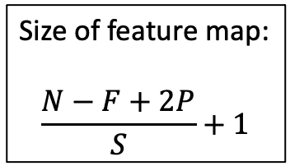
Example exercise
-1 1 0
-1 1 0
-1 1 0
Vertical edge filter
I want to detect vertical edges in this image
Size of feature map:
$$\frac{N−F+2P}{S}+1$$
0
0
0
0
1
1
2 | 0 | -2 | 1 | 0
3 | 0 | -3 | 2 | 0
2 | 0 | -2 | 2 | 0
0
1
1
Input
Feature map
Notes:
병찬
N: size of input
F: size of our filter
P: size of padding
S: stride
이걸 수평으로 갈때 계산해보면
N:7, F:3, P:0 S:1
=> 5
이걸 수직으로 갈때 계산해보면
N:5, F:3, P:0, S:1
3
계산할때 filter 를 덧씌운 다음에 곱해서 더하면 됨(직관적임)
Feature map 에서 결과를 해석할때
값이 0 이 아닌 방향으로 크다면 찾았다고 본다(절대값 크기로 선택)

Slide 9
What if I add padding?
-1 1 0
-1 1 0
-1 1 0
Vertical edge filter
Re-calculate the feature map
Size of feature map:
$$\frac{N−F+2P}{S}+1$$
0
0
0
0
0
0
1
1
0 | 2 | 0 | -2 | 1 | 0 | -1
0 | 3 | 0 | -3 | 2 | 0 | -2
0 | 2 | 0 | -2 | 2 | 0 | -2
0
0
1
1
Input
Feature map
Notes:
패딩을 붙일때에는 양쪽에 동일하게 붙인다.
그래서 저 계산식에서 2를 곱하는 이유가 패딩이 1개를 붙이면 양쪽에 붙으니 곱하기 2를 한다.
근데 여기서 패딩 붙인대로 1줄씩 만 붙이면 저기 표에서 처럼 (오른쪽 가장자리 -1, -2, -2) 값이 안나온다
패딩을 2개를 줘야 함. 그리고 Feature map 도 다시그려야 함.

Slide 10
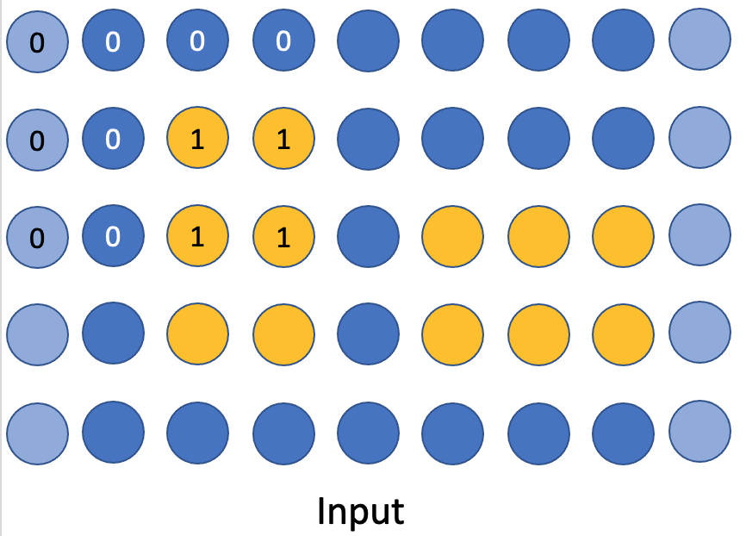
CNN example
Goal: count the number of vertical edges
Input
0 | 2 | 0 | -2 | 1 | 0 | -1
0 | 3 | 0 | -3 | 2 | 0 | -2
0 | 2 | 0 | -2 | 2 | 0 | -2
Max Abs
Output
Pooling
Feature map

Slide 11
What if I shift the image?
-1 1 0
-1 1 0
-1 1 0
Vertical edge filter
Will I still detect the same edges?
Size of feature map:
$$\frac{N−F+2P}{S}+1$$
0
0
0
0
0
1
1
0
0
1
1
0
Input
Notes:
Hw3 에 엑스트라 크레딧 2개 패딩을 붙여서 계산

Slide 12
Recurrent neurons
Feeds output as input backwards in the network
Feedback connection
Feedback connection

Slide 13
Recurrent neurons
Apply/optimize by unrolling the network over “time”

Slide 14
RNN example
Goal: what will a person order next?
Menu:
Burger
Fries
Soda
Milkshake
Apple pie
Ice cream
One-hot encoding:
[1, 0, 0, 0, 0, 0]
[0, 1, 0, 0, 0, 0]
[0, 0, 1, 0, 0, 0]
[0, 0, 0, 1, 0, 0]
[0, 0, 0, 0, 1, 0]
[0, 0, 0, 0, 0, 1]
Forget or remember?
Ex. sequences:
Burger, Soda, Ice cream
Burger, Fries, Milkshake, Apple pie
Input
Output

Slide 15
Autoencoders
Goal: compress information
Input layer
Code
Output layer

Slide 16
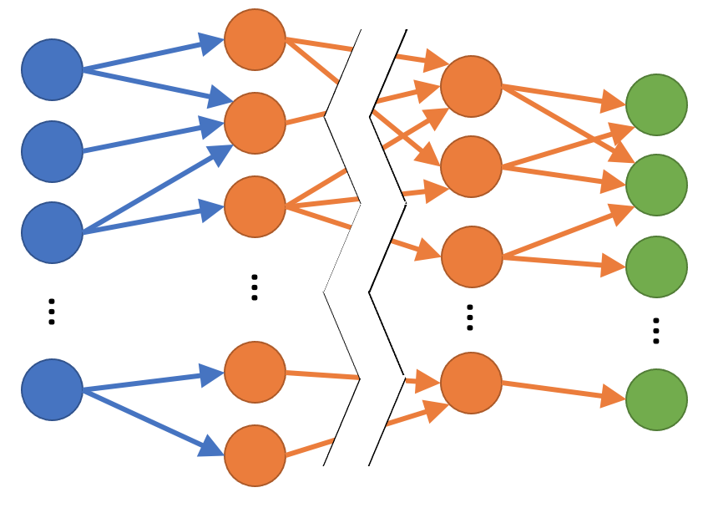
Generative Adversarial Neural Network
Goal: generate new data
Random seed
Generated data point
Real/Fake classification

Slide 17
AE + GANN example
Goal: increase the resolution of images
Output
Encoder
Decoder
Discriminator
Generator
Notes:
GAN 을 학습시키는것이 어렵기 때문에,
Autoencode 를 학습에 활용하겠다는것이 이 페이지의 요약.

Slide 18
Review
Special structures of DL neural networks
Pooling
Convolution
Recurrence
Special DL networks
Convolutional Neural network (CNN)
Recurrent Neural network (RNN)
Autoencoder (AE)
Generative Adversarial Neural network (GANN)

Slide 19
Homework
HW3 due next Tuesday (Sept. 27) at midnight
Programming Assignment 1 due Oct 12

